Slide 1
Chap 4: Fuzzy Logic
FSKKP, UMP
BCS2313: Artificial Intelligence Techniques

Slide 2
What You’ll Learn
Fuzzy Logic
Fuzzy Logic System
Type of Membership Function
Fuzzy Logic Problem & Solution

Slide 3
Fuzzy Logic Calculation

Slide 4
Fuzzy Logic System (FLS)
A fuzzy logic system (FLS) can be defined as the nonlinear mapping of an input data set to a scalar output data .
FLS consists of four main parts:
Fuzzifier
Rules
Inference engine
Defuzzifier.

Slide 5
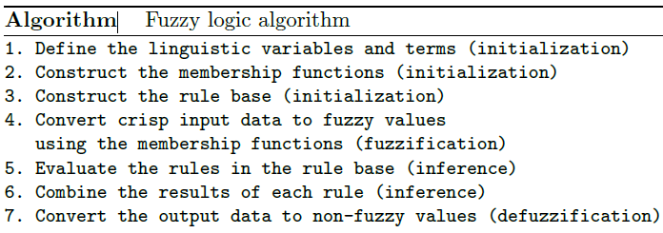
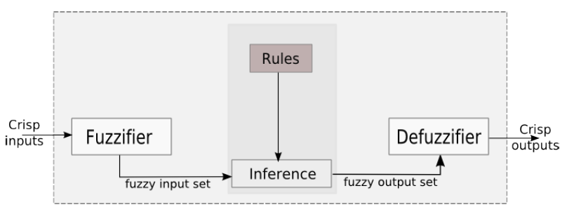
Fuzzy Logic System (FLS)

Slide 6
Fuzzy Logic System (FLS)
A crisp set of input data are gathered and converted to a fuzzy set using fuzzy linguistic variables, fuzzy linguistic terms and membership functions. This step is known as fuzzification.
Afterwards, an inference is made based on a set of rules.
The resulting fuzzy output is mapped to a crisp output using the membership functions, in the defuzzification step.

Slide 7
Membership Functions
Membership functions are used in the fuzzifcation and defuzzifcation steps of a fuzzy logic system (FLS), to map the non-fuzzy input values to fuzzy linguistic terms and vice versa.
A membership function is used to quantify a linguistic term.
There are many types of membership functions such as triangular, trapezoidal, piecewise linear, Gaussian and singleton

Slide 8
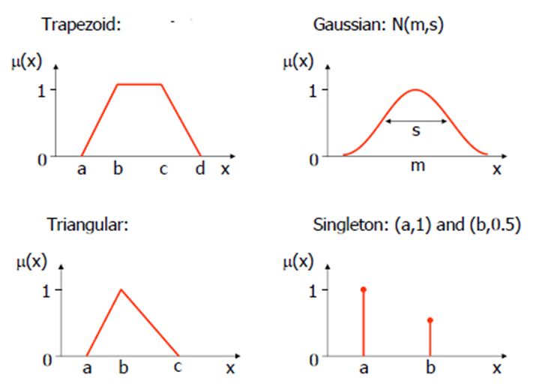
Types Membership Functions

Slide 9
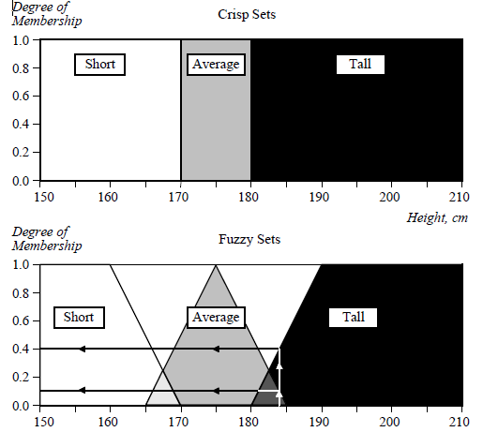
Crip Sets vs. Fuzzy Sets

Slide 10
Triangular Membership Functions
µ_{A}(x)
1
0
x
a
b
c
a, b and c represent the x coordinates of the three vertices of µA(x) in a fuzzy set A (a: lower boundary and c: upper boundary where membership degree is zero, b: the center where membership degree is 1)

Slide 11
Trapezoid Membership Functions
µ_{A}(x)
1
0
x
a
b
c
d
a, b, c and d represent the x coordinates of the four vertices of µA(x) in a fuzzy set A (a: lower boundary and d: upper boundary where membership degree is zero, b and c: the center line where membership degree is 1)

Slide 12
Problem
You have to developed a fuzzy logic system for intelligence speed control system for a car. The inputs of your system is the ambience temperature which taken form the car sensors, and cloud cover data taken weather data server. Your system should suggest the driver what is the appropriate speed base on the inputs.

Slide 13
Fuzzy Logic System (FLS)

Slide 14
1) Define Linguistic Variables & Terms
Temp: {Freezing, Cool, Warm, Hot}
Cover:{Sunny, Partly Cloudy, Overcast}
Speed:{Slow, Fast}

Slide 15
2) Construct Membership Functions
Input
Temp: {Freezing, Cool, Warm, Hot}
Cover: {Sunny, Partly Cloudy, Overcast}
Notes:
Cloudy values {a=20, b=45, c=80}

Slide 16
2) Construct Membership Functions
Output
Speed: {Slow, Fast}

Slide 17
3) Construct the Rule Based
If it's Sunny and Cool, drive Fast
Sunny(Cover)∧Cool(Temp)⇒ Fast(Speed)
If it's Sunny and Hot, drive Fast
Sunny(Cover)∧Hot(Temp)⇒ Fast(Speed)
If it's Cloudy and Warm, drive Slow
Cloudy(Cover)∧Warm(Temp)⇒ Slow(Speed)
If it's Cloudy and Cool, drive Slow
Cloudy(Cover)∧Cool(Temp)⇒ Slow(Speed)

Slide 18
4) Fuzzification: Convert Crips Input to Fuzzy Value
81 F° ⇒ Hot = ??, Warm= ??
23% Cover ⇒Sunny = ??, Cloudy = ??
Notes:
Cloudy values {a=20, b=45, c=80}

Slide 19
4) Fuzzification: Convert Crips Input to Fuzzy Value
81 F° ⇒ Hot = 0.55, Warm= 0.45
23% Cover ⇒Sunny = 0.85, Cloudy = 0.1
Notes:
Cloudy values {a=20, b=45, c=80}

Slide 20
5) Evaluate the Rule Based
If it's Sunny and Cool, drive Fast
Sunny(Cover)∧Cool(Temp)⇒ Fast(Speed)
If it's Sunny and Hot, drive Fast
Sunny(Cover)∧Hot(Temp)⇒ Fast(Speed)
If it's Cloudy and Warm, drive Slow
Cloudy(Cover)∧Warm(Temp)⇒ Slow(Speed)
If it's Cloudy and Cool, drive Slow
Cloudy(Cover)∧Cool(Temp)⇒ Slow(Speed)

Slide 21
5) Evaluate the Rule Based
If it's Sunny and Cool, drive Fast
Sunny(Cover)∧Cool(Temp)⇒ Fast(Speed)
If it's Sunny and Hot, drive Fast
Sunny(Cover)∧Hot(Temp)⇒ Fast(Speed)
If it's Cloudy and Warm, drive Slow
Cloudy(Cover)∧Warm(Temp)⇒ Slow(Speed)
If it's Cloudy and Cool, drive Slow
Cloudy(Cover)∧Cool(Temp)⇒ Slow(Speed)

Slide 22
6) Combine the Results of Each Rules
If it's Sunny and Hot, drive Fast
Sunny(Cover)∧Hot(Temp)⇒Fast(Speed)
0.85 ∧ 0.55 = 0.55
⇒ Fast = 0.55
If it's Cloudy and Warm, drive Slow
Cloudy(Cover)∧Warm(Temp)⇒Slow(Speed)
0.1 ∧ 0.45 = 0.10
⇒ Slow = 0.1

Slide 23
7) Defuzzification: Convert Fuzzy Data to Non-Fuzzy Value (Output)
Speed is 10% Slow and 55% Fast
Find centroids: Location where membership is 100%

Slide 24
7) Defuzzification: Convert Fuzzy Data to Non-Fuzzy Value (Output)
Speed is 10% Slow and 55% Fast
Find centroids: Location where membership is 100%

Slide 25
7) Defuzzification: Convert Fuzzy Data to Non-Fuzzy Value (Output)
Speed is 10% Slow and 55% Fast
Speed = weighted mean
= (10*25+...

Slide 26
7) Defuzzification: Convert Fuzzy Data to Non-Fuzzy Value (Output)
Speed is 10% Slow and 55% Fast
Speed = weighted mean
= (10*25+55*75)/(65)
= ? mph

